Slide 1

NETWORK INTRUSION DETECTION SYSTEM
USING MACHINE LEARNING
UNDER THE GUIDANCE OF
DR. GAJENDRA PRATAP SINGH
SCHOOL OF COMPUTATIONAL AND INTEGRATIVE SCIENCE
JNU, DELHI

Slide 2
WORK DONE BY
PRIYANSHU RANJAN SHIVAM
19/11/EC/041 19/11/EC/057
RAHUL JAISWAL SAGAR ARYA
19/11/EC/009 19/11/EC/061

Slide 3

INTRODUCTION
Network intrusion:
Network intrusion is the unauthorized access of a computer network or system by an individual or entity without permission.
The goal of a network intrusion is typically to compromise the security of the network or system by exploiting vulnerabilities or weaknesses.
Intrusions can result in theft, manipulation, or destruction of sensitive data, as well as disruption of normal operations.
Intrusions can be carried out through various means, such as hacking, phishing, social engineering, or exploiting security flaws in software or hardware.

Slide 4
Network Intrusion Detection System
An Intrusion Detection System (IDS) is a device or software application that monitors a network or systems for malicious activity or policy violations. It monitors system or network activity in real-time, analyzing data and looking for anomalies or patterns that indicate potential security threats.
Intrusion detection systems (IDSs) are designed to differentiate between normal connections and intrusions by analyzing network traffic and system logs for patterns or features that are indicative of malicious activity. IDSs can use machine learning algorithms to learn from historical data and automatically identify new patterns of malicious behavior. They can also use predefined rules or signatures to identify known attack patterns or anomalous behavior.

Slide 5

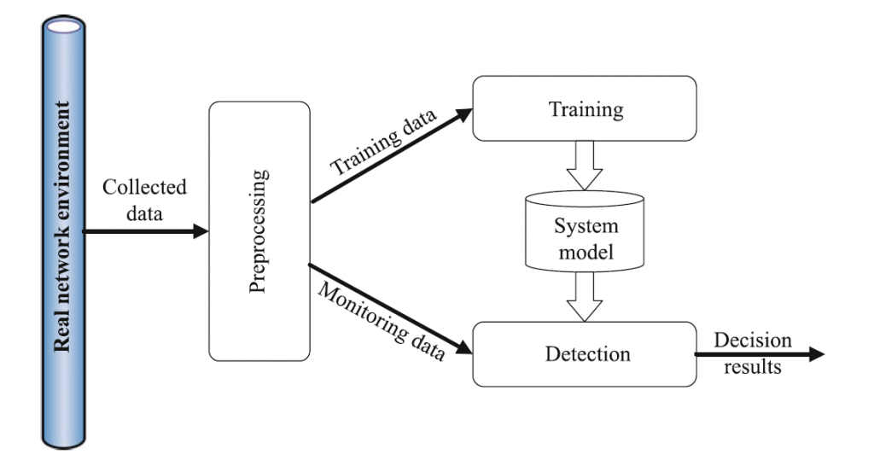

Slide 6

Need Of IDS
Building a reliable network is a very difficult task considering all different possible types of attacks. Nowadays, computer networks and their services are widely used in industry, business, and all areas of life and so does the number of attacks increased . Security personnel and everyone who has a responsibility for providing protection for a network and its users, have serious concerns about intruder attacks.
IDS becomes an essential part for building computer network to capture these kinds of attacks in early stages, because IDS works against all intruder attacks. IDS uses classification techniques to make decision about every packet pass through the network whether it is a normal packet or an attack (i.e. DOS, U2R, R2L, PROBE) packet.
The intrusion detector learning task is to build a predictive model (i.e. a classifier) capable of distinguishing between ``bad'' connections, called intrusions or attacks, and ``good'' normal connections.

Slide 7
DIFFERENT CLASSES OF ATTACKS
Denial of Service (DoS)
An attacker tries to prevent legitimate users from using a service. For example, SYN flood, Smurf and teardrop.
User to Root (U2R)
An attacker has local access to the victim machine and tries to gain super- user privilege. For example, buffer overflow attacks.
Remote to Local (R2L)
An attacker tries to gain access to victim machine without having an account on it. For example, password guessing attack.
Probe
An attacker tries to gain information about the target host. For example, port-scan and ping-sweep.

Slide 8

SIGNIFICANCE OF IDS
Improving network security: The project can contribute to improving network security by detecting and alerting system administrators to potential intrusions before they can cause significant harm. By using machine learning algorithms, the intrusion detection system can identify new patterns of malicious behavior and adapt to changing threat landscapes.
Reducing false positives: By using machine learning algorithms, the intrusion detection system can learn from historical data and identify complex patterns of normal behavior that may be indicative of an attack. This can reduce false positive rates, which are a common problem in traditional rule-based intrusion detection systems.
Enhancing system performance: By using machine learning algorithms, we can improve the efficiency & scalability of intrusion detection systems. Real-time threat detection and response are made possible by machine learning algorithms' ability to swiftly and reliably recognize patterns in vast amounts of data.
Enabling proactive security measures: By detecting potential threats in real-time, the intrusion detection system can enable proactive security measures such as blocking or quarantining suspicious network traffic, reducing the risk of a successful attack.

Slide 9

PROBLEM STATEMENT
The intrusion detector learning task is to build a predictive model (i.e. a classifier) capable of distinguishing between bad connections, called intrusions or attacks, and good normal connections.
DATA SOURCE
The data set used here is NSL KDD (new version of kdd-cup99).
we can easily download the data set from this link : https://www.unb.ca/cic/datasets/nsl.html
OBJECTIVE:
Given a data point, classify is it an attack or not -> Binary Classification

Slide 10

KPI(Key Performance Indicator)
AUC : its been known that when we have 2 class classification problem AUC is a good choice because it tell us the chance(in percentage) of classifying points.
f1 score and recall have been used in almost every paper and people work also , there is a reason because we want high precision and high recall for this task , which mean the f1 score is suitable.
Binary Confusion Matrix : for interpretation this metric will help us.

Slide 11

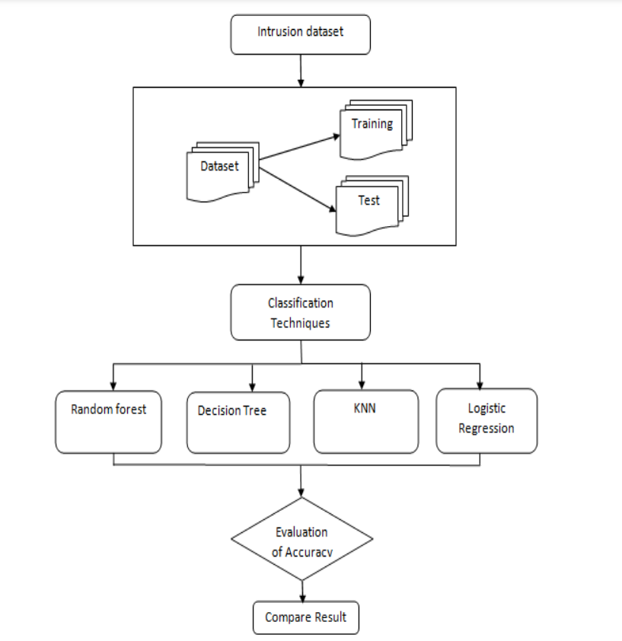
METHODOLOGY
Existing Approaches :
After cleaning , pre processing and some EDA people eliminate some useless feature and tried different model like svm , logistic regression etc with accuracy as their metric
Our Approach :
We have also done cleaning , pre processing and EDA and for feature elimination we have used something called recursive feature elimination and tried different basic ML model as well as some customized models . Taken auc as metric because when we have imbalanced data it is not suitable to used accuracy.

Slide 12
DATASET USED:NSL-KDD
The data collection process involves the selection of quality data for analysis. Here we used KDD intrusion dataset taken from https://www.unb.ca/cic/datasets/nsl.html for our machine learning implementation
The most popular dataset for benchmarking ML models for NIDS has been the NSL-KDD dataset
It is an updated, cleaned-up version of the original KDD Cup’99 dataset (released in 1999 and containing many redundant files)
DATA OVERVIEW:
we have mainly 2 data set
Train data : It has 125973 data points with 42 features
Test data : It has 22544 data points with 42 features

Slide 13
DATA CLEANING AND PREPROCESSING
Data Cleaning:
Checking for duplicates values
Checking for Null values
Data Preprocessing:
The purpose of preprocessing is to convert raw data into a form that fits machine learning. Structured and clean data will allows us to get more precise results from an applied machine learning model.
The task is to identify whether a given connection is normal or attack , for that we created a column "label" and gave all the attacks which are named normal as class 0 and all other attacks as class 1.

Slide 14
Checked for distribution with respect to different attacks in train and test dataset :
To analyze the feature we thought to analyse the categorical feature and numerical feature separately.
Univariate analysis on categorical feature:
we have 3 categorical feature : protocol type , service and flag and to analysis these categorical feature we gone have through 4 things:
-Number of category present in the dataset
-Distribution of the categorical feature
-featurization of the categorical feature using one hot encoding.
-How good is this protocol_type feature in predicting y_i ?
Univariate analysis on flag
Univariate analysis on continuous feature
Bivariate Analysis using pair plot
Multivariate analysis using tSNE

Slide 15

MODEL SELECTION AND TRAINING
The machine learning model which we will be using in this project are:
Naive Bayes: We will be using this as base line model because base line model should be simple so that we can compare it with other models.
KNN
Logistic Regression
Decision Tree
Random Forest
XgBoost
Normal Stacking Classifier
Custom Stacking Classifier
Feature Engineering

Slide 16

MODEL TRAINING
After we have preprocessed the dataset now we can proceed with a model training. This process is often known as “feeding” the algorithm with training data. An algorithm will process this data and output a model that is able to find whether the connection is a normal connection or an intrusion on new data we want to know with predictive analysis. The purpose of model training is to develop a model.
We will now use this data to train all the algorithms mentioned in above slide.

Slide 17

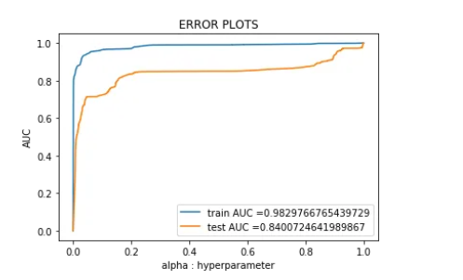
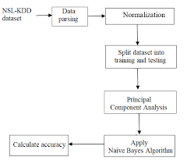
MODEL EVALUATION
Naive Bayes Classification
training data f1 score is 0.9258446608869385
test data f1 score is 0.7687546886721681
training data recall score / detection rate is 0.8852294047415998
test recall score / detection rate is 0.6388217875788982
Observations:
There is a difference between the train & test AUC values, indicating that the model is overfitting.
Let us perform some feature selection to minimize overfitting.
We will pick features using recursive feature elimination.

Slide 18
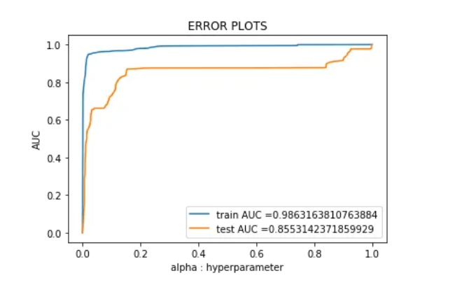
Naive Bayes With Hyperparameter Tuning
Training data f1 score is 0.9607209835382371
Test data f1 score is 0.773419258429065
Training data recall score / detection rate is 0.9436465973051339
Test data recall score / detection rate is 0.6452894880386504
Observation :
1 -> class 0 & 2 -> class 1
After deleting certain extraneous features, the f1 score & recall both improve slightly.
There appears to be some uncertainty regarding recall: 64% of all actual points is predicted to be a class 2 and about 36% are expected to be class 0.

Slide 19

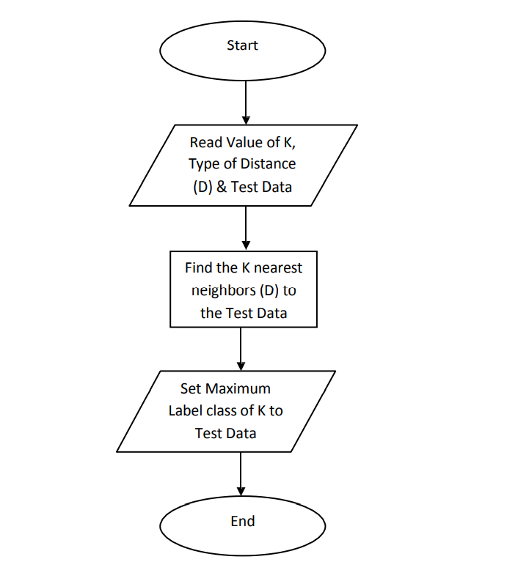
KNN HYPER PARAMETER TUNING
Training data f1 score is 0.9902896052698944
Test data f1 score is 0.7806070670726082
Training data recall score / detection rate is 0.9897322190005117
Test data recall score / detection rate is 0.6593158263851009
Observation :
1 -> class 0 & 2 -> class 1
This simple knn model gives us greater AUC, f1, and recall value, which is a good indicator.
Nonetheless, there is still considerable misunderstanding in the recall on test results between classes 2 and 1.
This could be due to a disparity in class.

Slide 20
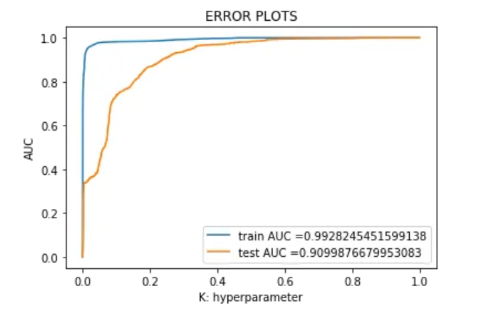
LOGISTIC REGRESSION HYPERPARAMETER TUNING
Training data f1 score is 0.9671355060034306
Test data f1 score is 0.7264708642207001
Training data recall score / detection rate is 0.9616919665700153
Test data recall score / detection rate is 0.6032883971012234
Observation :
1 -> class 0 & 2 -> class 1
Although the model's f1 and recall are lower than those of the baseline model, it has a high auc value.
Also, recall model does have some ambiguity here.

Slide 21
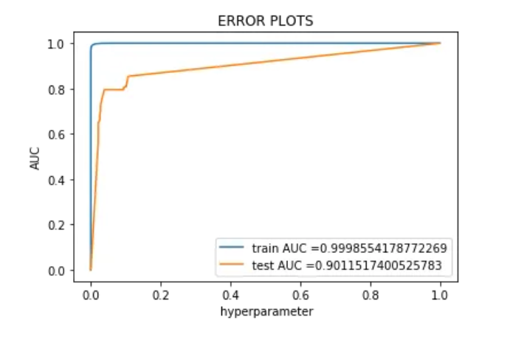
DECISION TREE WITH HYPERPARAMETER TUNING
Training data f1 score is 0.9694895073671678
Test data f1 score is 0.8820999316637859
Training data recall score or detection rate is 0.9999317755415317
Test data recall score or detection rate is 0.8549832463180862
Observation :
1 -> class 0 & 2 -> class 1
This is currently our best available model.
After implementing some class balancing, we achieved rather high AUC, F1 scores, and recall.
Model is no longer as confused as it was previously on classes 1 and 0.

Slide 22

THANK
YOU

Slide 23
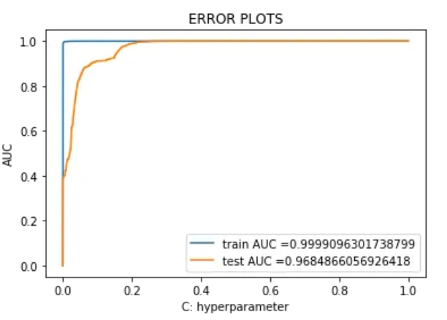
RANDOM FOREST HYPERPARAMETER TUNING
Training data f1 score is 0.9812059973378651
Test data f1 score is 0.8754566307025742
Training data recall score / detection rate is 0.9995565410199556
Test data recall score / detection rate is 0.8030078703342944
Observation :
1 -> class 0 & 2 -> class 1
In terms of AUC, this model performs better than other models; it also has a strong f1 and recall value, although not as well as Decision tree.

Slide 24
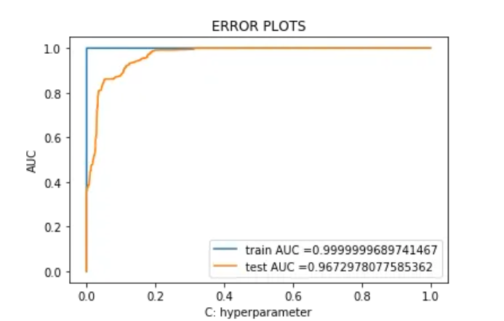
XGBOOST HYPERPARAMETER TUNING
Training data f1 score is 0.999880615342634
Test data f1 score is 0.7592960544990066
Training data detection rate/recall is 0.9999488316561488
Test data Detection rate/recall is 0.6253409179459207
Observation :
1 -> class 0 & 2 -> class 1
The xgboost model does not work as planned.
It cannot recollect the test data properly.

Slide 25
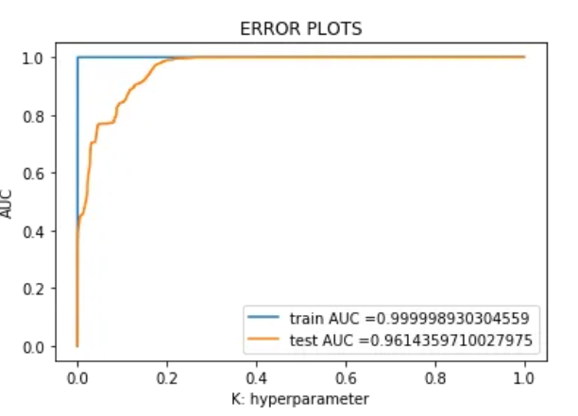
BASIC STACKING CLASSIFIER
Training data f1 score is 0.9994799259960271
Test data f1 score is 0.7843464552325313
Training data recall score / detection rate is 0.9997441582807437
Test data recall score / detection rate is 0.6590820540793267
Observation:
Above model is a standard staking model in which I took all of the models and stacked them.
Every model output should be passed to the meta classifier.
We also received a good auc score, but not a great f1 score or recall.

Slide 26
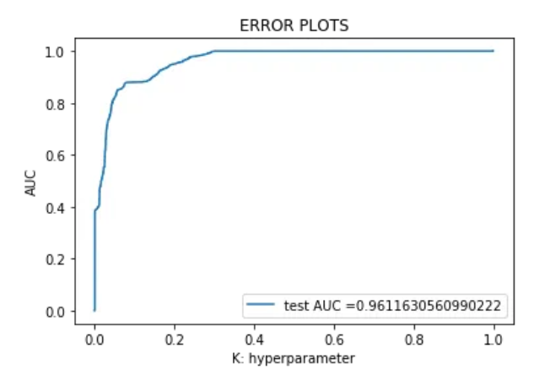
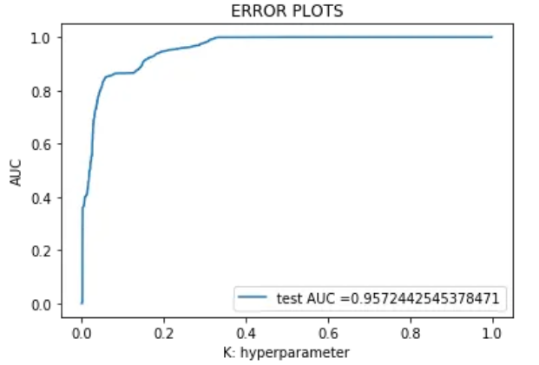
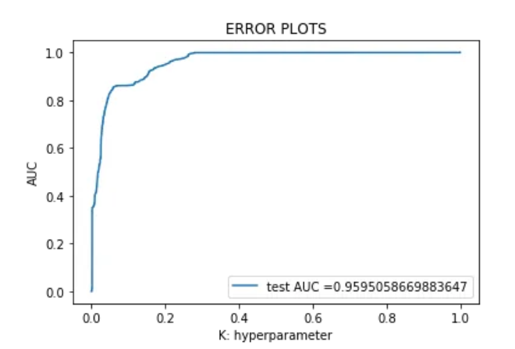
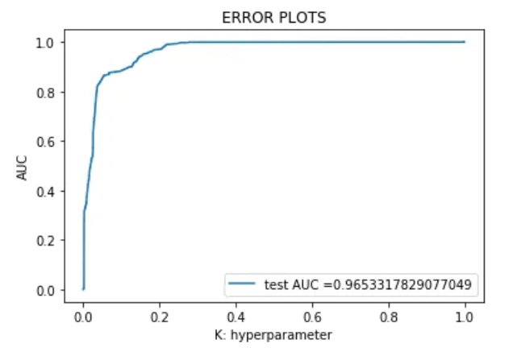
CUSTOMIZED STACKING CLASSIFIER
with 1000 sample
with 1500 sample
with 2000 sample
10000 data point and 100 samples

Slide 27
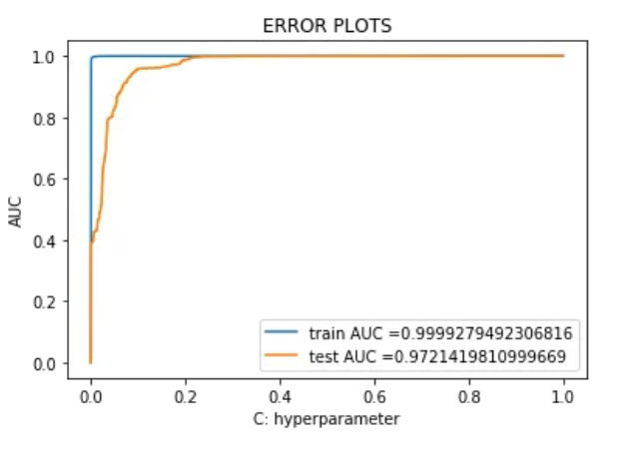
FEATURE ENGINEERING WITH RANDOM FOREST
Training data f1 score is 0.9871886660545977
Test data f1 score is 0.8739645724480694
Training data recall score / detection rate is 0.9995053726761044
Test data recall score / detection rate is 0.8016052364996493
Observation:
This model produces the greatest auc value, outperforming our prior random forest model.

Slide 28
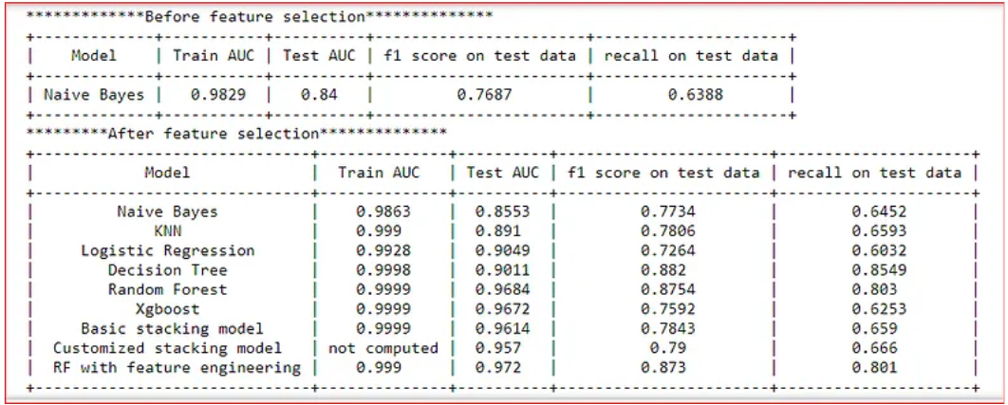
RESULT

